Slide 1

AeroBin
Predictive Justice For Clean Air
AEROBIN · PUNE PILOT
AeroBin
An early-warning and dispatch system for open waste burning in Pune
Three tools, one dataset: a resident-facing alert map, a PMC officer dispatch console, and a funder-facing impact scorecard — built and tested on a real 12-week, 5-ward pilot.
Zaid Khan
1M1B Internship · Green Skills and Applied AI for Climate Action

Slide 2

THE PROBLEM
Open waste burning is a health risk PMC can’t see coming
WHY IT MATTERS
5
What
Residents burn garbage in the open — especially in low-income wards with sparse municipal collection — sending PM2.5 spikes through nearby neighborhoods with no warning and no record of what happened.
Pune wards in the pilot, chosen to include low-income, sparse-sensor areas
0
Who’s affected
Residents breathing the smoke, PMC ward officers who only hear about it after the fact, and the city’s broader air-quality targets under the National Clean Air Programme.
wards had any early-warning system before this pilot
A real example from the pilot data
100%
Burn-risk scores spiked into the High band across multiple wards in the weeks right after Diwali — the data’s own “post-festival week” flag — exactly when informal waste and firecracker-debris burning surges and existing systems had no way to flag it in advance.
of dispatch decisions are now logged and auditable
2 / 8

Slide 3

INSIGHTS & RESEARCH
12 weeks, 5 wards, real pilot numbers
KEY INSIGHT
The dataset behind AeroBin isn’t hypothetical — it’s a simulated 12-week pilot (Oct–Dec) across Hadapsar, Kharadi, Wagholi, Bhosari, and Mundhwa, built on CPCB 2022–24 baselines and real ESG report targets, with 9 tracked metrics across Environmental, Social, and Governance categories.
Risk spikes cluster where sensors are thinnest.
Wagholi and Bhosari — the pilot’s low-income, sparse-sensor wards — showed the highest and most volatile burn-risk scores of all five wards, and the widest model-accuracy gap versus the better-instrumented wards.
85 → 71.2 µg/m³
28.8%
PM2.5 fell over the pilot — short of the 68 target, but a real, measured improvement, not a projection
SMS alert adoption — below the 50% target, and the single clearest constraint the pilot surfaced
That’s why the app tracks a dedicated equity-gap metric, not just an average.
87.1%
2 of 3
of high-risk alerts were actioned by PMC within 24 hours, above the 80% target
replication conditions met — the pilot is honest about not being fully ready to scale yet
3 / 8

Slide 4




THE SOLUTION
Three tools, one dataset, one mission
Instead of one dashboard trying to serve everyone, AeroBin is three small, single-purpose apps — each answering exactly one person’s question, driven by the same data-derived burn-risk score (0–100, banded red / amber / green).
STREET LEVEL
OPERATIONS
LEADERSHIP
Citizen Alert
PMC Dispatch
Impact Analyst
“Is my ward burning today?”
“Which wards need a truck?”
“Did the pilot work? Ready to scale?”
Live map, today’s high-risk wards, one tap to the nearest free dump point. Mobile-first, with a bottom-sheet detail view.
Officer console with a live dispatch queue, hover map tooltips, and a 100%-logged, auditable decision trail.
9-metric ESG scorecard, a 12-week scrubbable playback, and an exportable readiness report for funders.
Built with: React 19 + Vite · Leaflet (live ward maps) · Recharts (trend analytics) · OpenWeatherMap Air Pollution API (live PM2.5) · localStorage-backed audit trail
4 / 8

Slide 5

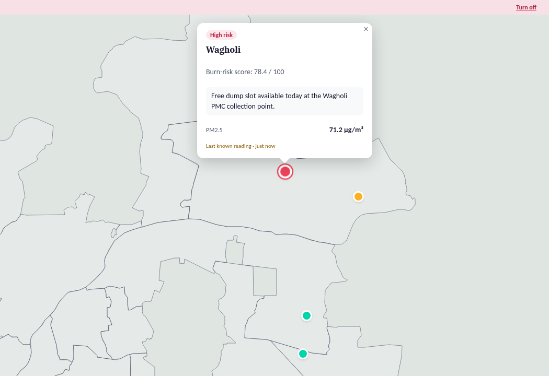
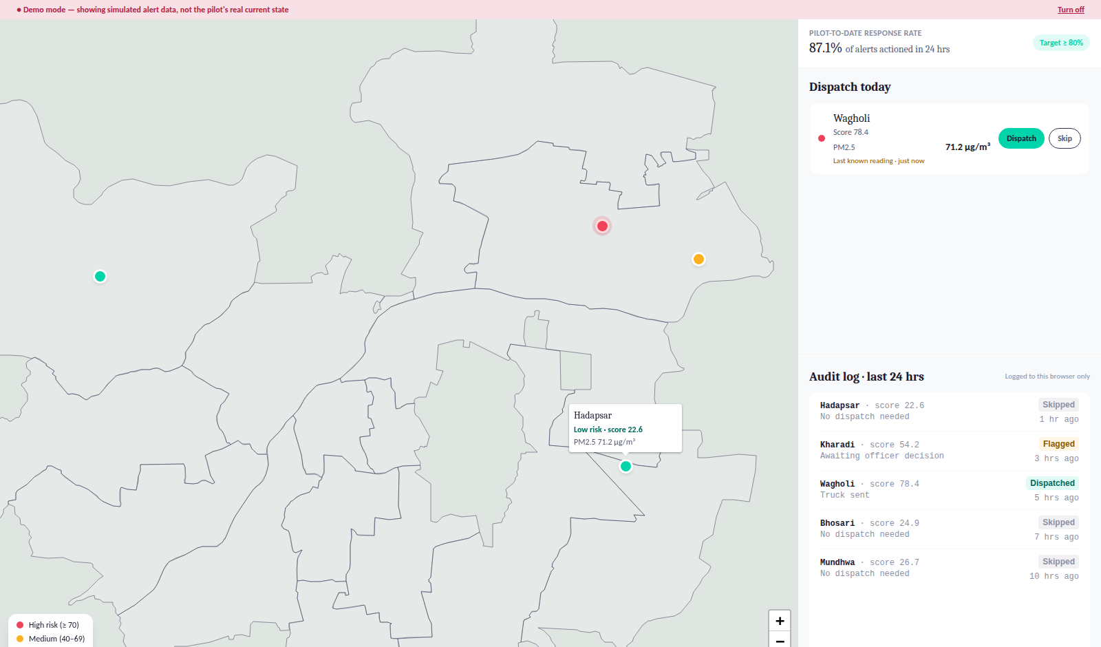
PROTOTYPE
What residents and PMC officers actually see
CITIZEN ALERT
PMC DISPATCH
Tap a ward → see its risk band, score, and the nearest free dump point. A pulsing red marker means High risk; the bottom banner counts today’s alerts city-wide.
One click logs a dispatch decision — permanently auditable. Hovering any marker shows ward name, risk, and PM2.5 without a click.
5 / 8

Slide 6
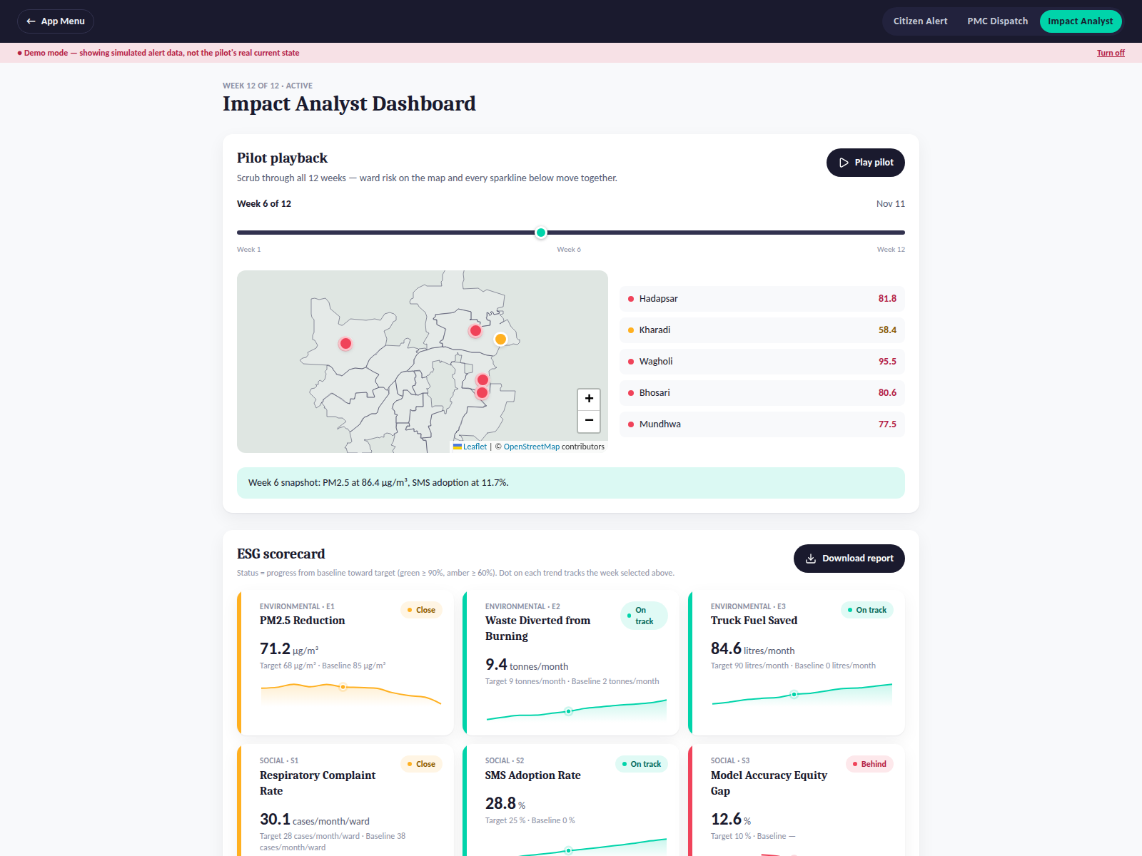
PROTOTYPE
What funders and PMC leadership see
Pilot Playback
Scrub or auto-play all 12 weeks — the map, ward list, and every ESG sparkline’s tracking dot move together, so the trend and the map never tell two different stories.
Honest status derivation
Green / amber / red on every metric comes from a single, auditable rule (progress from baseline to target) — not a judgment call.
One-click export
A funder-ready JSON report — all 9 metrics, phase progress, replication readiness — downloads directly from the scorecard.
6 / 8

Slide 7


IMPACT & IMPLEMENTATION
Tested like a real product, not just demoed
Every feature was verified interacting with a real headless browser — not just read from the code and assumed to work — across 30+ automated scenarios covering all three apps, mobile layout, and the full dispatch/demo-mode lifecycle.
KEY RESULTS
Dispatch audit trail: 100% of decisions logged, matching the pilot’s own governance metric
A CHALLENGE, HONESTLY TOLD
The dispatch button wouldn’t reset
87.1% PMC alert-response rate reproduced live in the Dispatch console
A demo-mode toggle for showcasing alert states left a ward stuck showing “Logged” even after turning demo mode off and back on.
First fix attempt — comparing a stored “was this demo mode” flag — looked right on paper but failed on re-test: the flag can’t tell “still the same session” from “a new one after a round trip through off.”
Zero console errors and zero lint warnings across the full build
Accessibility bugs found by real contrast math — not eyeballing — and fixed: several risk badges measured as low as 1.7:1 contrast (fails WCAG AA); now 5.6–6.6:1
The real fix: clear the log at the one place demo mode actually changes, not by detecting staleness afterward. Re-tested three ways — full navigation cycle, live in-page toggle, repeat cycle — all clean.
7 / 8

Slide 8




WHAT’S NEXT
From pilot to city-wide accountability
Three things stand between this pilot and a real PMC deployment.
Next milestone
Support required
How it scales
A live burn-detection source (satellite NASA FIRMS, or a PMC data-sharing agreement) replacing the static pilot snapshot
A PMC pilot partnership to test Dispatch with real ward officers, not simulated data
2 of 3 replication conditions already met; SMS adoption (28.8% vs. 50%) is the one gap to close first
A real backend (Firebase/Supabase) so dispatch logs persist across officers and devices
Hosting, plus a live OpenWeatherMap key wired in for production PM2.5
The same 3-app pattern replicates ward-by-ward to any city with comparable pilot data
AeroBin — Zaid Khan · 1M1B Internship on Green Skills and Applied AI for Climate Action
8 / 8

